Slide 1
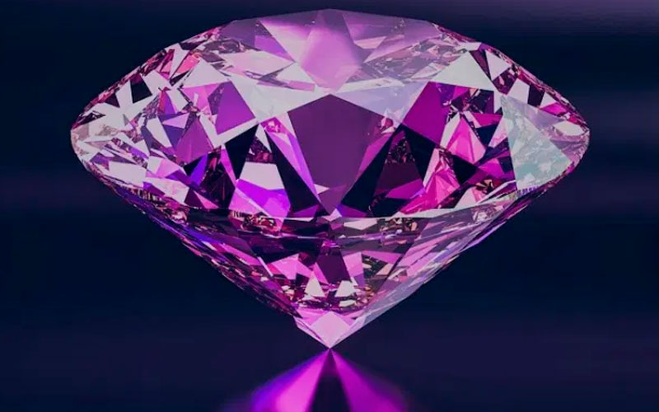
Project- Kaggle
Eduardo Rivera

Slide 2
Different Models
-Linear Regression: RMSE around 1200
-Gradient boosting regressor: RMSE around 620
-Random Forest Regressor: RMSE around 590
-Auto ML: RMSE around 530

Slide 3
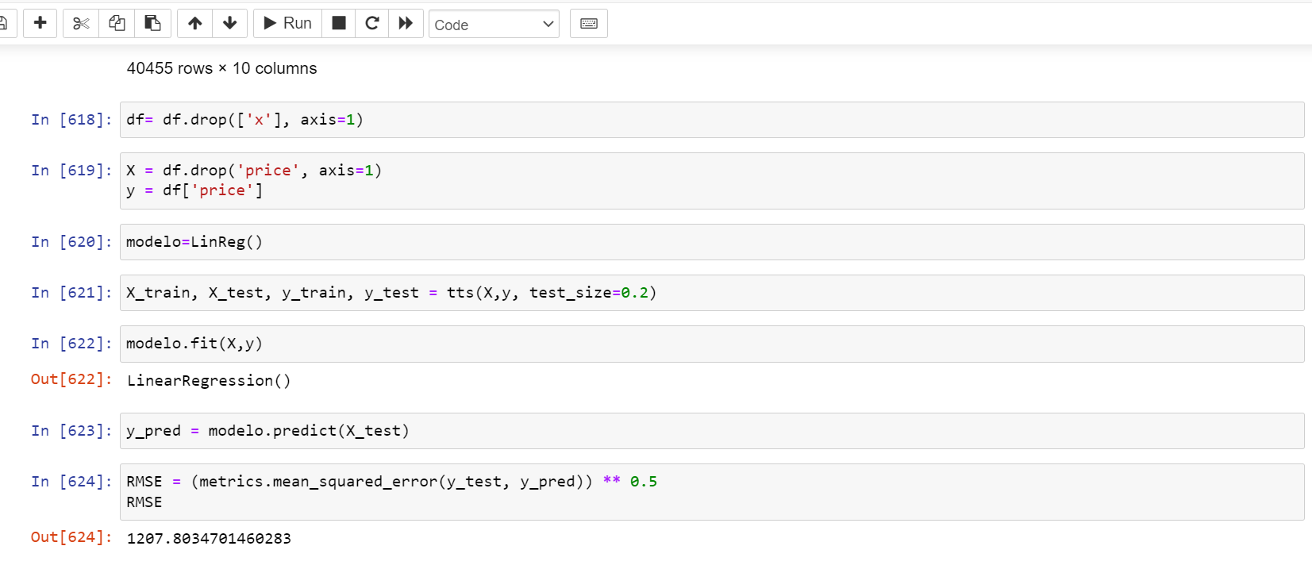
Linear Regression

Slide 4
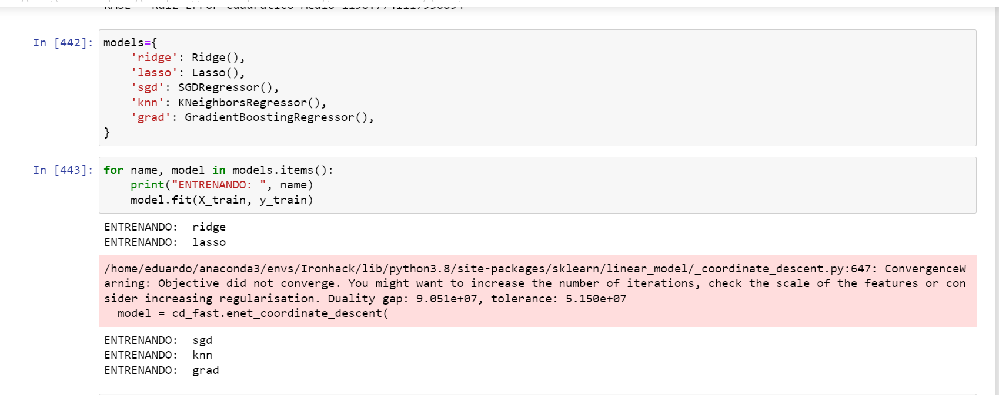
Gradient Boosting Regressor

Slide 5
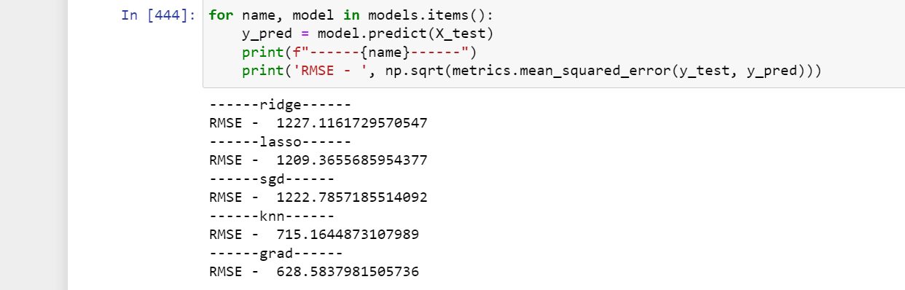
Gradient Boosting Regressor

Slide 6
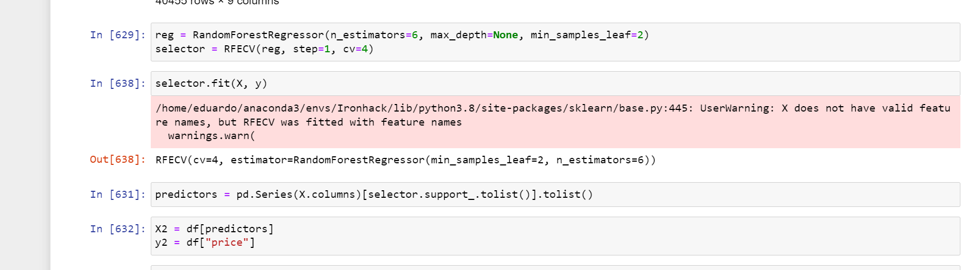
Random Forest Regressor

Slide 7
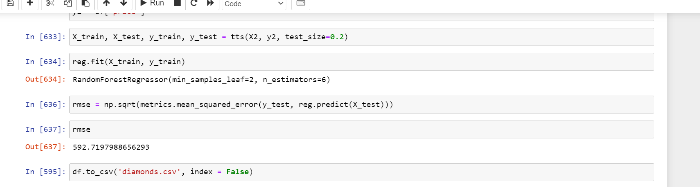
Random Forest Regressor

Slide 8
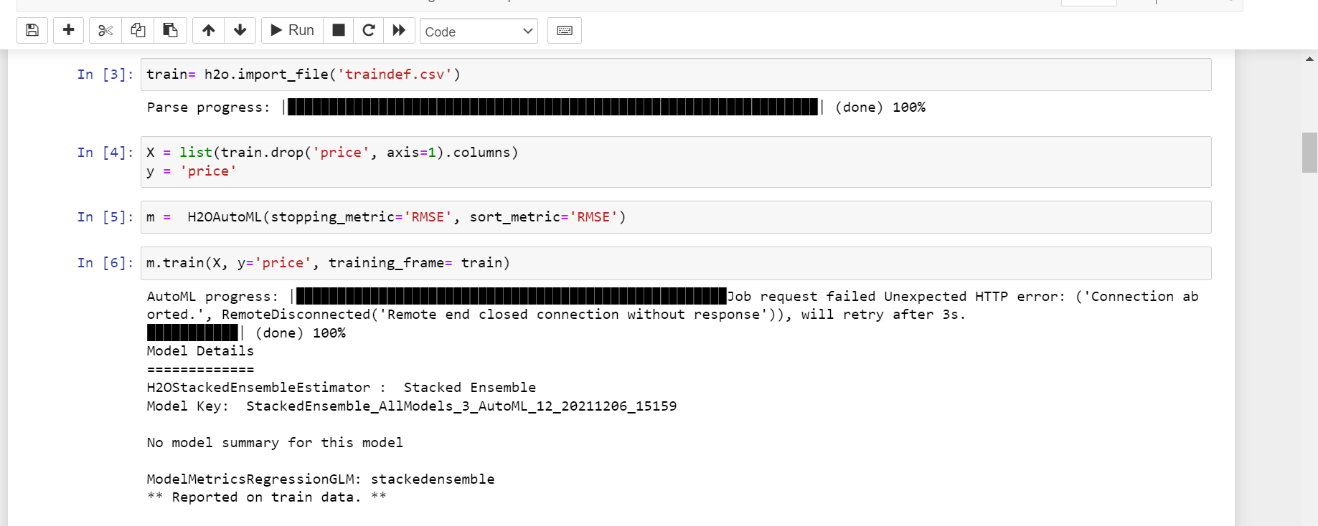
H2o Auto ML

Slide 9
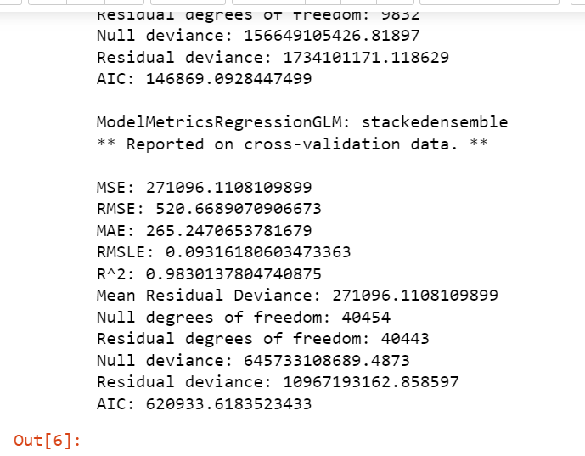
H2o Auto ML

